Slide 1


Computer Graphics
Computer Animation

Slide 2
LET US ENTER INTO THE MAGICAL WORLD OF ANIMATION

Slide 3
Contents
INTRODUCTION
APPLICATIONS
DESIGN OF ANIMATION SEQUENCES
GENERAL COMPUTER ANIMATION FUNCTIONS
RASTER ANIMATIONS
COMPUTER ANIMATION LANGUAGES
KEY FRAME SYSTEMS
MOTION SPECIFICATIONS

Slide 4
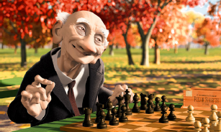
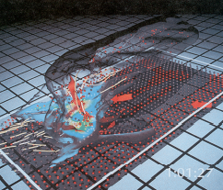
Computer Animation
What is Animation?
Make objects change over time according to scripted actions
What is Simulation?
Predict how objects change over time according to physical laws

Slide 5

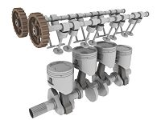
Introduction
Computer animation is the process used for generating animated images (moving images) using computer graphics.
Animators are artists who specialize in the creation of animation.
From Latin animātiō, "the act of bringing to life"; from animō ("to animate" or "give life to") and -ātiō ("the act of").
2D ANIMATION
3D ANIMATION

Slide 6
APPLICATIONS
Video games
cartoon
Mobile phones

Slide 7
Design Of Animation Sequences
Steps for designing animation sequences.
Storyboard Layout
Object definitions
Key frame specifications
Generation of in-between frames

Slide 8
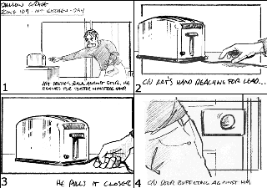
Storyboard Layout

Slide 9
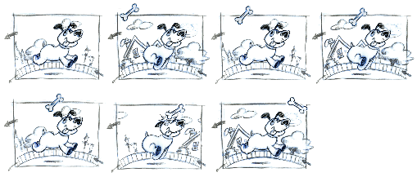
Object Definitions

Slide 10
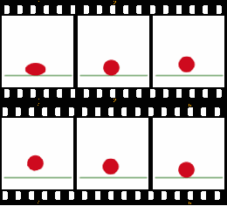
Key frame Specifications

Slide 11
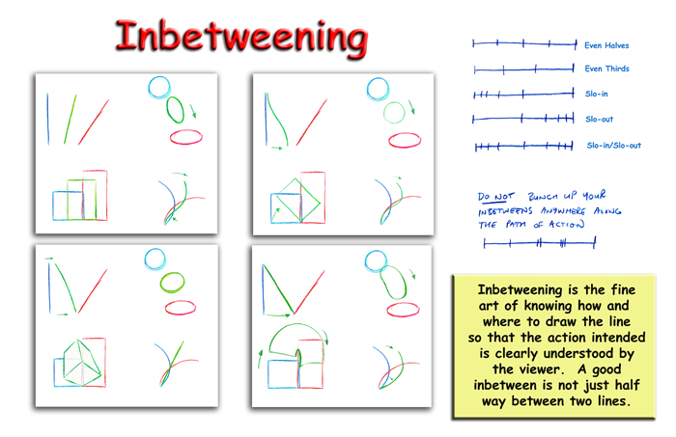
In-between frames

Slide 12
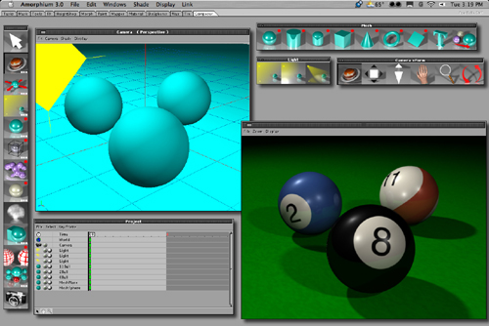
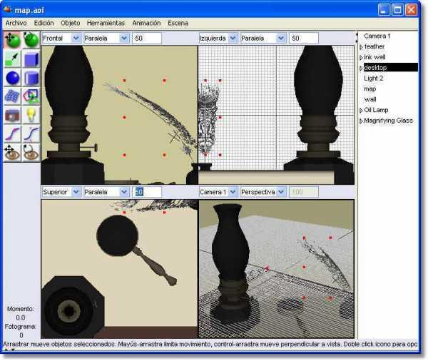
GENERAL COMPUTER ANIMATION FUNCTIONS
Animation software provide basic functions to create animation and process the individual object.
Manipulate data object database.
FUNCTIONS
Motion generation.
Object rendering.
Amorphium
Art of illusion

Slide 13
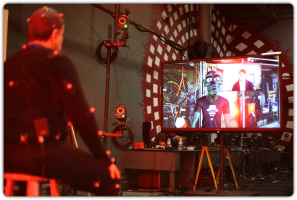
Raster Animations
Real-time animations can be generated using raster operations.

Slide 14
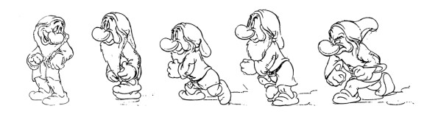
Computer Animation Languages
GENERAL PURPOSE LANGUAGES:
C,C++,Pascal, or Lisp(control animation sequences).
Scene description
Graphics editor
Key frame generator, inbetween frame,
Action specificaiton-motion paths
Positioning of object, surface illumination, camera parameters, spline surface.

Slide 15
SPECIALIZED ANIMATION LANGUAGES
Key frame systems
Parameterized systems
Scripting systems

Slide 16
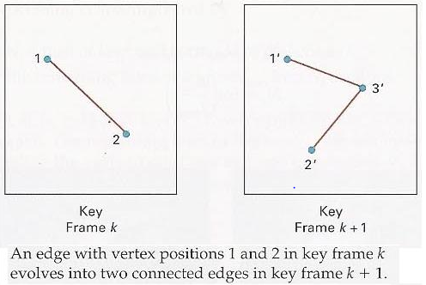
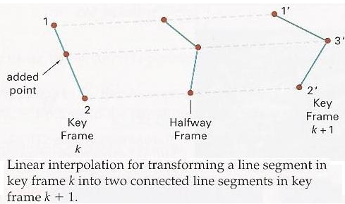
Key frame Systems/Morphing

Slide 17
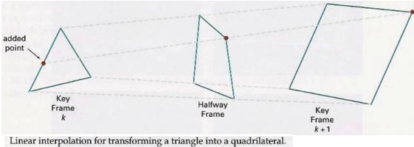

Slide 18
Motion Specifications
Various ways in which motions of objects ca be specified as:
Direct Motion Specification.
Goal-Directed Systems.
Kinematics and Dynamics.

Slide 19
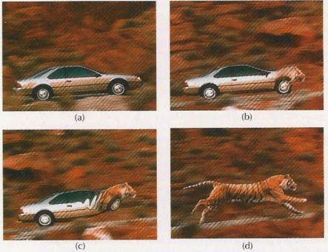
Direct Motion Specification

Slide 20
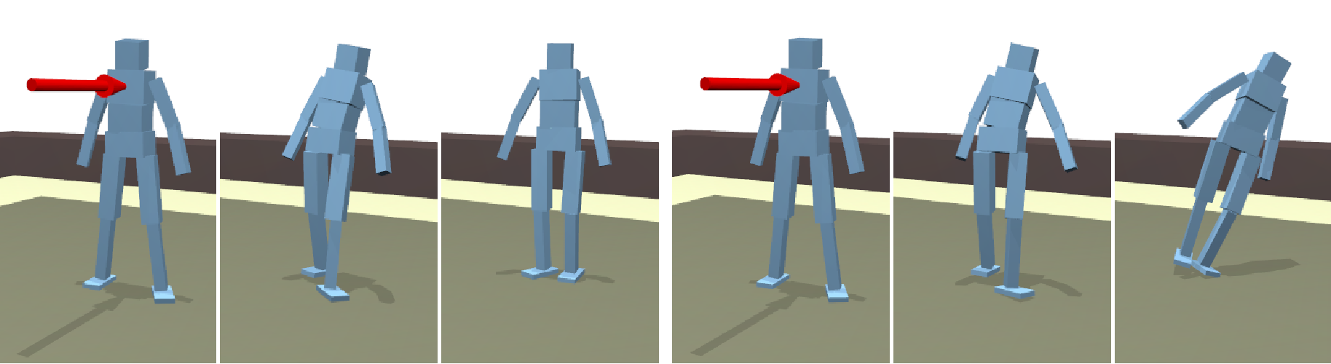
Goal Directed System

Slide 21
Kinematics and Dynamics
KINEMATICS:
Motion parameters such as position , velocity and acceleration are specified without reference to the forces.
INVERSE KINEMATICS:
Initial and final positions of objects at specified times and from that motion parameters .
DYNAMICS:
The forces that produce the velocities and accelerations are specified(physically based modeling).
It uses laws such as Newton’s laws of motion , Euler or Navier -stokes equations.

Slide 22
Principle of Traditional Animation
Squash and Stretch
Slow In and Out
Anticipation
Exaggeration
Follow Through and Overlapping Action
Timing
Staging
Straight Ahead Action and Pose-to-Pose Action
Arcs
Secondary Action
Appeal

Slide 23
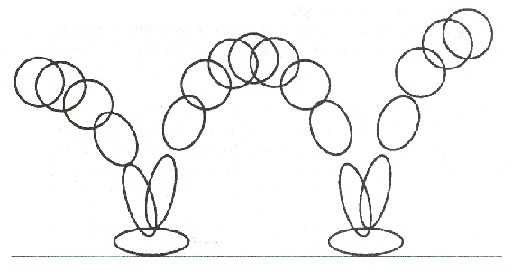
Squash and Stretch
Stretch
Squash

Slide 24
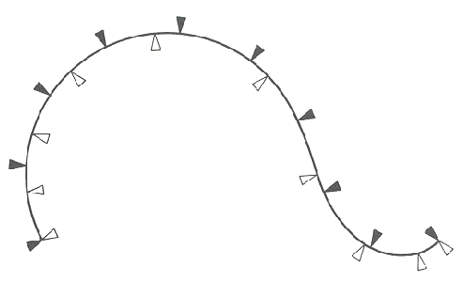
Slow In and Out

Slide 25
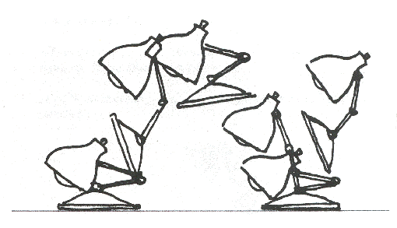
Anticipation

Slide 26
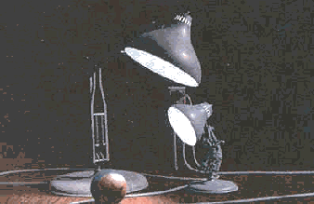
Computer Animation
Animation Pipeline
3D modeling
Motion specification
Motion simulation
Shading, lighting, & rendering
Postprocessing

Slide 27
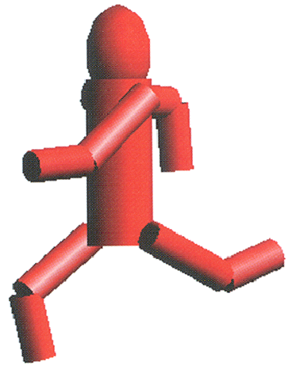
Outline
Principles of Animation
Keyframe Animation
Articulated Figures

Slide 28
Keyframe Animation
Define Character Poses at Specific Time Steps Called “Keyframes”

Slide 29
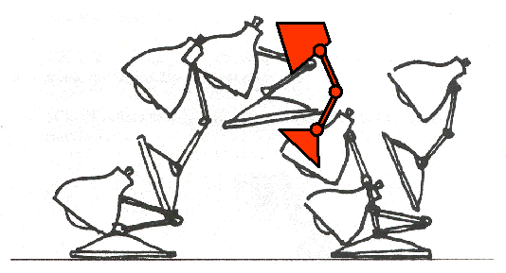
Keyframe Animation
Interpolate Variables Describing Keyframes to Determine Poses for Character in between

Slide 30
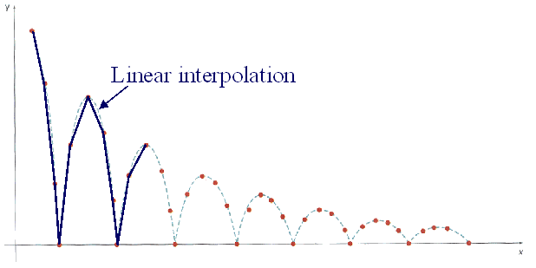
Inbetweening
Linear Interpolation
Usually not enough continuity

Slide 31
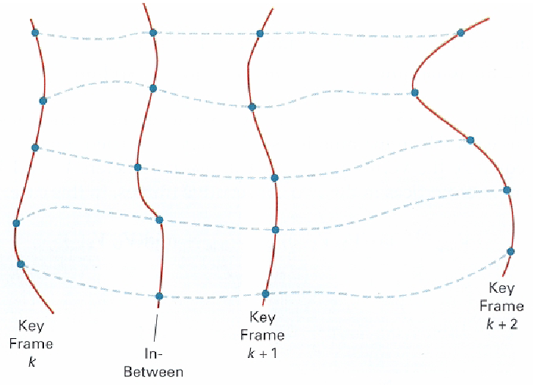
Inbetweening
Spline Interpolation
Maybe good enough

Slide 32
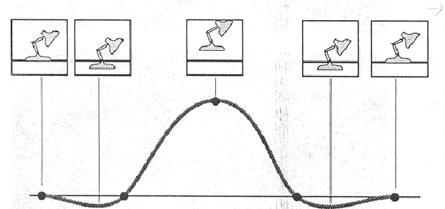
Inbetweening
Spline Interpolation
Maybe good enough
May not follow physical laws

Slide 33
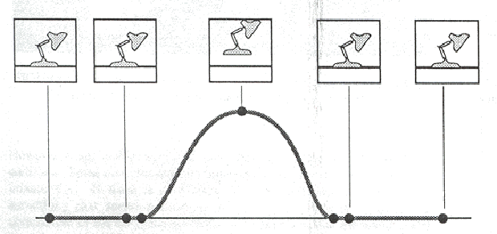
Inbetweening
Spline Interpolation
Maybe good enough
May not follow physical laws

Slide 34
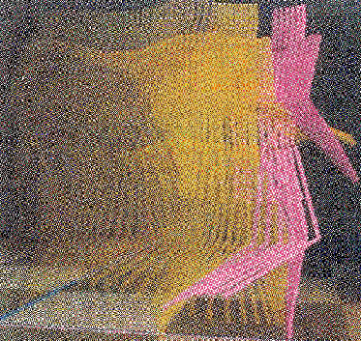
Inbetweening
Inverse Kinematics or Dynamics

